Slide 1
1010043316
Analysis and Design of Algorithms
Unit 1: Basics of Algorithms, Mathematics and Analysis of Algorithm
SEMESTER: 5

Slide 2
TOPICS
What is an algorithm?,
Properties of Algorithm, Time and Space Complexity,
detailed analysis of algorithm,
Mathematics for Algorithmic : Sets, Functions and Relations,
Vectors and Matrices,
Linear Inequalities and Linear Equations.

Slide 3
What is an algorithm?
Algorithm: It is the finite sequence of operations/instructions which transform the given input to correct output.
Algorithms must be
Finite – must eventually terminate.
Complete – always gives a solution when there is one.
Correct (sound) – always gives a “correct” solution.

Slide 4
Properties of algorithms
Input from a specified set,
Output from a specified set (solution),
Definiteness of every step in the computation,
Correctness of output for every possible input,
Finiteness of the number of calculation steps,
Effectiveness of each calculation step and
Generality for a class of problems.

Slide 5
Problems & Instance
Problem: Multiply two positive integers
Instance:
(10,2) is proper instance for above problem
(-5,2) is not proper instance
(10,2.5) is again not proper instance
Algorithm must work correctly on every instance it claims to solve
How to show that it works incorrect?
Find any one instance for which it doesn’t work correctly

Slide 6
Efficiency of Algorithms
Which algorithm needs to be chosen when more than one algorithm is available?
Three Approaches:
Empirical (Posteriori)
programming all the techniques and trying them of different instances.
Theoretical (Priori):
determining mathematically the quantity of resources needed as a function of the size of instance.
Resources: computing time, storage space.
Hybrid approach:
Algo’s efficiency is determined theoretically and required numerical parameters are determined empirically.

Slide 7
Empirical Approach
The algorithm has to be implemented, which may take a long time and could be very difficult.
Results may not be indicative for the running time on other inputs that are not included in the experiments.
In order to compare two algorithms, the same hardware and software must be used.

Slide 8
Theoretical Approach
Uses a high-level description of the algorithm instead of an implementation
Characterizes running time as a function of the input size, n.
Takes into account all possible inputs
Allows us to evaluate the speed of an algorithm independent of the hardware/software environment

Slide 9
Principle of Invariance
What is the unit for storage space measurement?
What is the unit for time measurement?
Principle of Invariance: Two different implementations of the same algorithms will not differ in efficiency by more than some multiplicative constant.
Example: t1(n) and t2(n) are the time for any algorithm for different implementations, then there exist “c” & “d” such that ..
t1(n) <= c * t2(n)
t2(n) <= d* t1(n)
Means, the running time of either implementation is bounded by a constant multiple of the running time of the other.

Slide 10
Common time complexities
Best
O(1) constant time
O(log n) log time
O(n) linear time
O(n log n) log linear time
O(n2) quadratic time
O(n3) cubic time
O(2n) exponential time
Worse

Slide 11
The Growth Rate of the Six Popular functions
n | logn | n | nlogn | n² | n³ | 2^{n}
4 | 2 | 4 | 8 | 16 | 64 | 16
8 | 3 | 8 | 24 | 64 | 512 | 256
16 | 4 | 16 | 64 | 256 | 4,096 | 65,536
32 | 5 | 32 | 160 | 1,024 | 32,768 | 4,294,967,296
64 | 6 | 64 | 384 | 4,094 | 262,144 | 1.84 * 10¹⁹
128 | 7 | 128 | 896 | 16,384 | 2,097,152 | 3.40 * 10³⁸
256 | 8 | 256 | 2,048 | 65,536 | 16,777,216 | 1.15 * 10⁷⁷
512 | 9 | 512 | 4,608 | 262,144 | 134,217,728 | 1.34 * 10¹⁵⁴
1024 | 10 | 1,024 | 10,240 | 1,048,576 | 1,073,741,824 | 1.79 * 10³⁰⁸

Slide 12
Average, Best and Worst Case
Usually we would like to find the average time to perform an algorithm
However, Sometimes the “average” isn’t well defined
Example: Sorting an “average” array
Time typically depends on how out of order the array is
Sometimes finding the average is too difficult
Often we have to be satisfied with finding the worst (longest) time required
Sometimes this is even what we want (say, for time-critical operations)
The best (fastest) case is seldom of interest

Slide 13
Set
Set is a collection of well-defined objects or elements.
A set is represented by a capital letter symbol and the number of elements in the finite set is represented as the cardinal number of a set in a curly bracket {…}.
For example, set A is a collection of all the natural numbers, such as A = {1,2,3,4,5,6,7,8,…..∞}
Sets can be represented in three forms:
Roster Form: Example- Set of even numbers less than 8={2,4,6}
Statement Form: Example-A = {Set of Odd numbers less than 9}
Set Builder Form: Example: A = {x: x=2n, n ∈ N and 1 ≤ n ≤ 4}

Slide 14
What are the types of Sets?
Empty Set or Null set: It has no element present in it.Example: A = {} is a null set.
Finite Set: It has a limited number of elements.Example: A = {1,2,3,4}
Infinite Set: It has an infinite number of elements.Example: A = {x: x is the set of all whole numbers}
Equal Set: Two sets which have the same members.Example: A = {1,2,5} and B={2,5,1}: Set A = Set B
Subsets: A set ‘A’ is said to be a subset of B if each element of A is also an element of B.Example: A={1,2}, B={1,2,3,4}, then A ⊆ B
Universal Set: A set which consists of all elements of other sets present in a Venn diagram.Example: A={1,2}, B={2,3}, The universal set here will be, U = {1, 2,3}

Slide 15
What are the types of Sets?
Singleton Set : Singleton Sets are those sets that have only 1 element present in them. Set A= {1} is a singleton set as it has only one element, that is, 1.
Equivalent Set : Equivalent Sets are those which have the same number of elements present in them. It is important to note that the elements may be different in both sets but the number of elements present is equal. Set A= {2, 3, 5, 7, 11} Set B = {p, q, r, s, t}
Set A and Set B both have 5 elements hence, both are equivalent sets.
Disjoint Sets : For any two sets A and B which do have no common elements are called Disjoint Sets. The intersection of the Disjoint set is ϕ, now for set A and set B A∩B = ϕ.

Slide 16
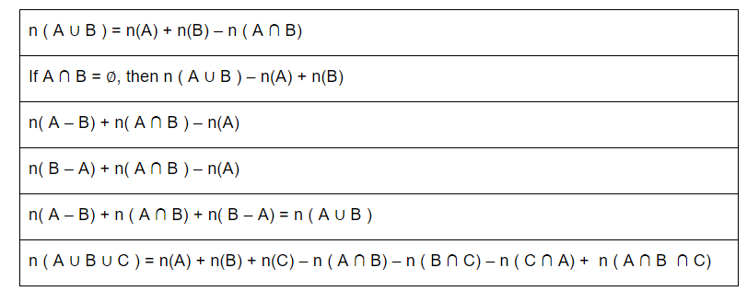
Formulas For Sets

Slide 17
Power set
The power set of a set A is defined as the set of all subsets of the Set A including the Set itself and the null or empty set.
For Example: A = {1, 3, 5}
Power set of A, P(A) = {{}, {1}, {3}, {5}, {1,3}, {3,5}, {1,5}, {1,3,5}}

Slide 18
Cartesian product of Sets
Cartesian product of Sets
Let’s assume A and B to be two non-empty sets, the sets of all ordered pairs (x, y) where x∈A and y∈B is called a Cartesian product of the sets.
A × B = {x, y | x∈A and y∈B}
Ordered Pair : An ordered pair is a pair of objects where one element is assigned first, and the other element is assigned second, denoted by (a,b). Here ‘a’ is called the first component, and ‘b’ is called the second component of the ordered set.

Slide 19
Properties of Cartesian Product
The Cartesian Product is non-commutative: A × B ≠ B × A
The cardinality of the Cartesian Product is defined as the number of elements in A × B and is equal to the product of cardinality of both sets: |A × B| = |A| * |B|
A × B = {∅}, if either A = {∅} or B = {∅}

Slide 20
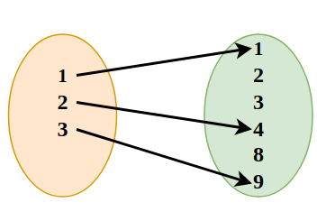
Relation
A relation from set A to set B is a subset of the cartesian product set A x B. The subset is made up by describing a relationship between the first element and the second element of elements in A x B.
Example: R = {(1,1), (2, 4), (3,9)}
Domain {1,2,5}
Range : {1,4,9}

Slide 21
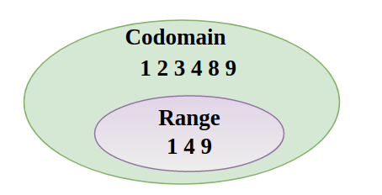
Domain , Range & Codomain
Domain of any Relation is the set of input values of the relation. For example, if we take two sets A and B, and define a relation R: {(a,b): a ∈ A, b ∈ B} then the set of values of A is called the domain of the function.
Range of any Relation is the set of output values of the relation. For example, if we take two sets A and B, and define a relation R: {(a,b): a ∈ A, b ∈ B} then the set of values of B is called the domain of the function.
We define the codomain of the relation R as the set B of the cartesian product A×B on which the relation is defined. Now it is clear that the range of the function is the proper subset of Codomain.
R = {(9,11), (10,12), (11,13)}
Thus,
Domain of R is (9, 10, 11)
Range of R is (11, 12, 13)
Codomain is (4, 5, 6, 9,10,11,12,13, 17)

Slide 22
Types of Relation
Empty Relation- There is no relation between any elements of a set.
Universal Relation- Every element of the set is related to each other.
Identity Relation- In an identity relation, every element of a set is related to itself only.
Inverse Relation- Inverse relation is seen when a set has elements that are inverse pairs of another set.
Reflexive Relation- In a reflexive relation, every element maps to itself.
Symmetric Relation- In asymmetric relation, if a=b is true then b=a is also true.
Transitive Relation- For transitive relation, if (x, y) ∈ R, (y, z) ∈ R, then (x, z) ∈ R.
Equivalence Relation- A relation that is symmetric, transitive, and reflexive at the same time.

Slide 23
Function
A function is a special kind of relation. It is a relation in which each domain value maps only to one range value. It is denoted by ƒ:X⇒Y
What this means that it is a function from X to Y. It takes input from set X and gives the unique value from set Y as output. “X” is called the domain of the function while “Y” is called the co-domain.

Slide 24
Types of Function
Identity function: The function defined by y = f (x) = x for each x ∈ R.
Constant function: The function defined by y = f(x) = C, x ∈ R.
Polynomial function: f(x) = anxn + an-1xn-1 + ….. + a0
Rational function: These are function of the form p(x)/q(x).

Slide 25
VECTORS
A k-dimensional vector y is an ordered collection of k real numbers y1, y2, . . . , yk , and is written as y = (y1, y2, . . . , yk ). The numbers y j (j = 1, 2, . . . , k) are called the components of the vector y.
Ex: (1, −3, 0, 5) is a four-dimensional vector. Its first component is 1, its second component is −3, and its third and fourth components are 0 and 5, respectively.
Scalar multiplication of a vector y = (y1, y2, . . . , yk ) and a scalar α is defined to be a new vector z = (z1,z2, . . . ,zk ), written z = αy or z = yα, whose components are given by z_{j} = αy _{j}
Vector addition of two k-dimensional vectors x = (x1, x2, . . . , xk ) and y = (y1, y2, . . . , yk ) is defined as a new vectorz = (z1,z2, . . . ,zk ), denoted z = x+y, with components given by z_{j} = x_{j} +y_{j}

Slide 26
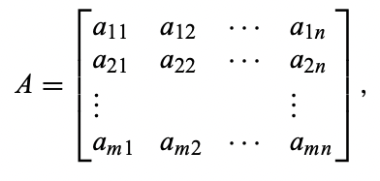
MATRICES
We can now extend these ideas to any rectangular array of numbers, which we call a matrix.
A matrix is defined to be a rectangular array of numbers.
whose dimension is m by n. A is called square if m = n. The numbers ai j are referred to as the elements of A.

Slide 27
Types Matrices
Two matrices A and B are said to be equal, written A = B, if they have the same dimension and their corresponding elements are equal, i.e., a_{i j} = b_{i j} for all i and j.
A k-by-1 matrix is called a column vector and a 1-by-k matrix is called a row vector.
The identity matrix of order m, written Im (or simply I, when no confusion arises) is a square m-by-m matrix with ones along the diagonal and zeros elsewhere.
An elementary matrix is a square matrix with one arbitrary column, but otherwise ones along the diagonal and zeros elsewhere (i.e., an identify matrix with the exception of one column).

Slide 28
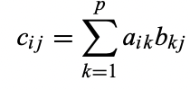
Operation on Matrices
Scalar multiplication of a matrix A and a real number α is defined to be a new matrix B, written B = αA or B = Aα, whose elements b_{i j} are given by b_{i j} = αa_{i j}
Addition of two matrices A and B, both with dimension m by n, is defined as a new matrix C, written C = A + B, whose elements c_{i j} are given by c_{i j} = a_{i j} + b_{i j}
The product of an m-by-p matrix A and a p-by-n matrix B is defined to be a new m-by-n matrix C, written C = AB, whose elements c_{i j} are given by:

Slide 29
Operation on Matrices
The transpose of a matrix A, denoted A t , is formed by interchanging the rows and columns of A; that is, a^{t}_{i j} = a _{ji}

Slide 30
Linear Inequalities and Linear Equations
Linear inequalities: Linear inequalities are the expressions where any two values are compared by the inequality symbols such as, '<', '>', '≤' or '≥'. These values could be numerical or algebraic or a combination of both.
Linear Equations : A linear equation in one unknown can always be stated into the standard form ax = b , Where x is an unknown and a and b are constants. If a is not equal to zero, this equation has a unique solution x=b/a.
Examples : x>6
x+y+2z>16
q+q<20

Slide 31
Linear Inequalities and Linear Equations
Linear Equation with 2 variables unknown:
a₁x+b₁y=c₁
a₂x+b₂y=c₂
Solution of above equations can obtained by elimination method.

Slide 32
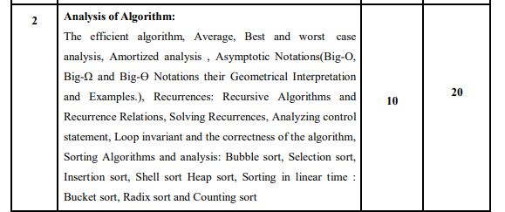

Slide 33
PERFORMANCE ANALYSIS
There are problems and algorithms to solve them.
Problems and problem instances.
Example: Sorting data in ascending order.
  Problem: Sorting
  Problem Instance: e.g. sorting data (2 3 9 5 6 8)
  Algorithms: Bubble sort, Merge sort, Quick sort, Selection sort, etc.
Which is the best algorithm for the problem? How do we judge?

Slide 34
PERFORMANCE ANALYSIS
Two criteria are used to judge algorithms: (i) time complexity (ii) space complexity.
Space Complexity of an algorithm is the amount of memory it needs to run to completion.
Time Complexity of an algorithm is the amount of CPU time it needs to run to completion.

Slide 35
SPACE COMPLEXITY
Why?
  To know in advance about sufficient memory
  To select the program with minimum memory requirement
  To estimate the largest instance it can solve

Slide 36
COMPONENTS OF SPACE COMPLEXITY
Instruction space
  Space needed to store the compiled version of program instruction
  Depends on…
    The compiler used to compile the program
      Ex. a+b + (b*c) + (a+b-c) / (a+b)/4
    The compiler options in effect
      Ex. Overlay option
    The target computer
      Floating point hardware

Slide 37
COMPONENTS OF SPACE COMPLEXITY
2. Data space
  Space needed by constants and simple variables
  Space needed by dynamically allocated objects (arrays, class instance etc.)
3. Environmental stack space
  The return address
  All local variables
  All formal parameters
  Recursion stack space
    The space needed by local variables & formal parameters
    The maximum depth of recursion

Slide 38
SPACE COMPLEXITY
Memory space S(P) needed by a program P, consists of two components:
  A fixed part: needed for instruction space (byte code), simple variable space, constants space etc. 🡪 c
  A variable part: dependent on a particular instance of input and output data. 🡪 S_{p}(instance)
S(P) = c + S_{p}(instance)

Slide 39
SPACE COMPLEXITY: EXAMPLE 1
Algorithm abc (a, b, c)
{
return a+b+b*c+(a+b-c)/(a+b)+4.0;
}
For every instance 3 computer words required to store variables: a, b, and c. Therefore Sp()= 3. S(P) = 3.

Slide 40
SPACE COMPLEXITY: EXAMPLE 2
Algorithm Sum(a[], n)
{
s:= 0.0;
for i = 1 to n do
s := s + a[i];
return s;
}
Every instance needs to store array a[] & n.
  Space needed to store n = 1 word.
  Space needed to store a[ ] = n floating point words (or at least n words)
  Space needed to store i and s = 2 words
S_{p}(n) = (n + 3). Hence S(P) = (n + 3).

Slide 41
SPACE COMPLEXITY: EXAMPLE 3
Algorithm RSum(a[], n)
{
if (n > 0)
return Rsum(a,n-1) + a[n-1];
return 0;
}
Every recursive function call needs to store address of array a[], the value of n & return address.
  Space needed to store n = 1 word.
  Space needed to store the address of a[ ] = 1 word
  Space needed to store return address = 1 words
  Depth of recursion = n+1
  Space needed to store a[] = n words
S_{p}(n) = n. Hence S(P) = 3(n + 1) + n.

Slide 42
SPACE COMPLEXITY: EXAMPLE 4
Algorithm Fact(int n)
{
if (n <= 1)
return 1;
else return (n * Fact(n-1));
}
Every recursive function call needs to store the value of n & return address.
  Space needed to store n = 1 word.
  Space needed to store return address = 1 words
  Depth of recursion = n
Hence S(P) = 2(n)

Slide 43
TIME COMPLEXITY
Time required T(P) to run a program P also consists of two components:
  A fixed part: compile time which is independent of the problem instance 🡪 c.
  A variable part: run time which depends on the problem instance 🡪 t_{p}(instance)
T(P) = c + t_{p}(instance)

Slide 44
TIME COMPLEXITY
How to measure T(P)?
  Measure experimentally, using a “stop watch”
    T(P) obtained in secs, msecs.
  Count no. of major operations / instructions.
    Identify one or more major operations and determine how many times each is executed.
    Ignore the other minor operations / instructions.
  Count program steps 🡪 T(P) obtained as a step count.
Fixed part is usually ignored; only the variable part t_{p}() is measured.

Slide 45
OPERATION COUNT : EXAMPLE 1
Algorithm IndexOfMax(int a[], int n)
{
int index = 0;
for(int i=1; i<n; i++)
if (a[index] < a[i])
index = i;
return index;
}
  Comparison can be considered as major operation in above algorithm.
  Total number of comparison = max{n-1, 0 }
  Hence, T(P) = n-1

Slide 46
OPERATION COUNT : EXAMPLE 2
Algorithm PolyEval(int coeff[], int n, int x)
{
int y=1, value=coeff[0] ;
for(int i=1; i<=n; i++)
{
y = y * x;
value = value + y * coeff[i];
}
}
  Here, additions and multiplications can be identified as major operations.
    Total number of additions = n
    Total number of multiplications = 2n
  Hence, total number of operations = 3n
  T(P) = 3n

Slide 47
STEP COUNT
Considers all executable statements of an algorithm.
What is a program step?
  a+b+b*c+(a+b)/(a-b) 🡪 one step;
  comments 🡪 zero steps;
  while (<expr>) do 🡪 step count equal to the number of times <expr> is executed.
  for i=<expr> to <expr1> do 🡪 step count equal to number of times <expr1> is checked.

Slide 48
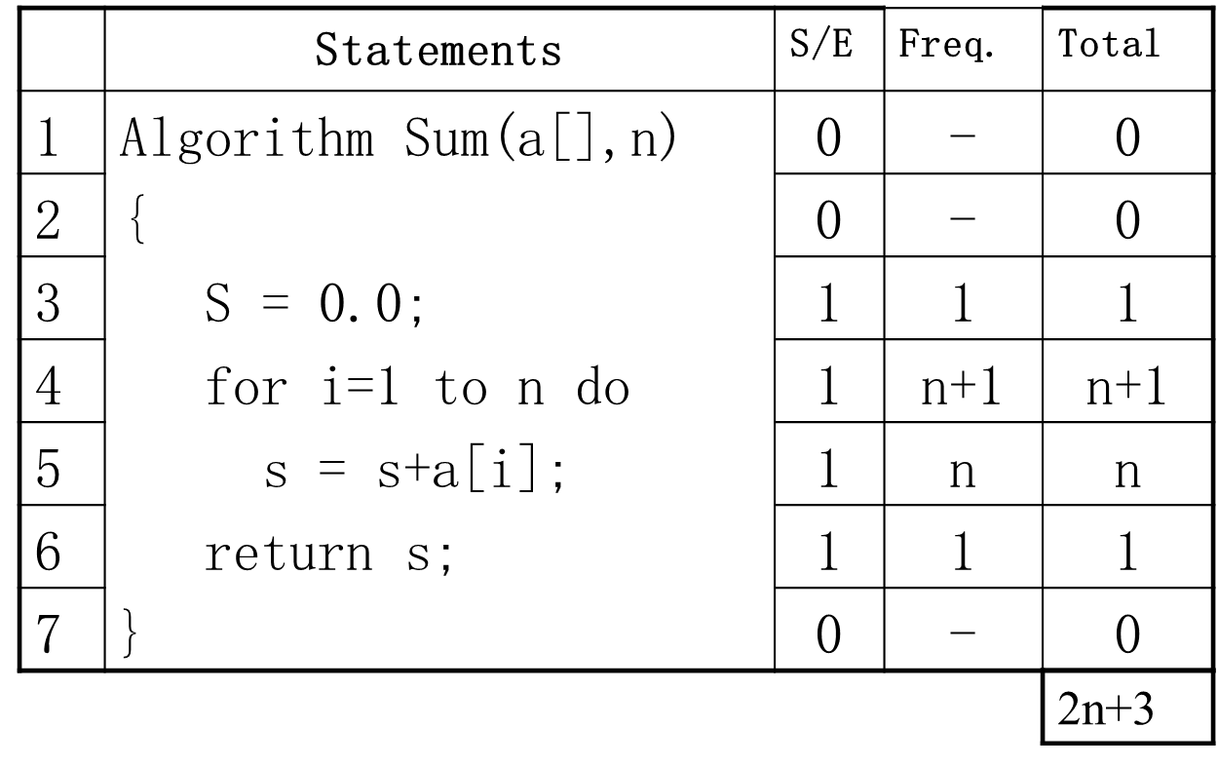
STEP COUNT : EXAMPLE 1

Slide 49
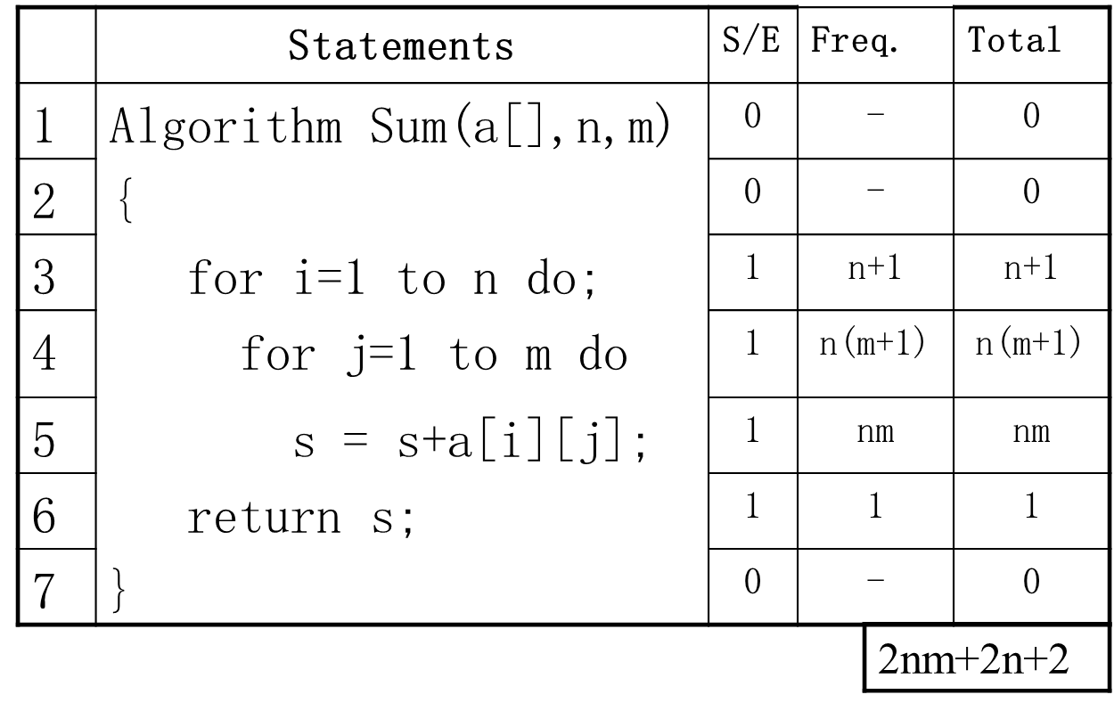
STEP COUNT : EXAMPLE 2

Slide 50
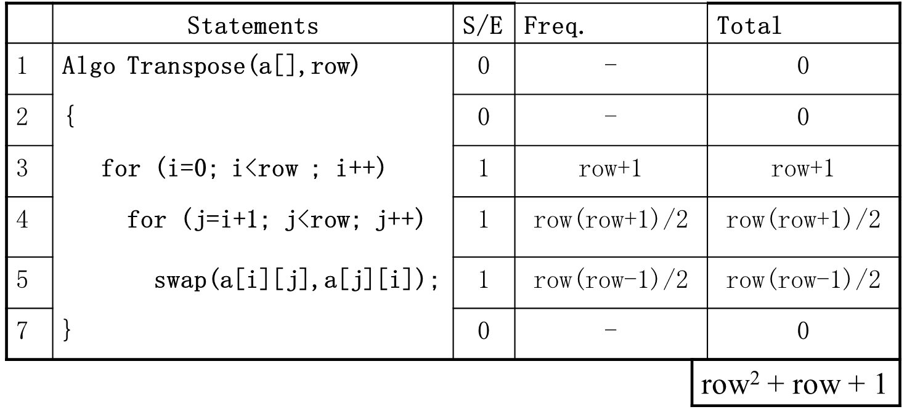
STEP COUNT : EXAMPLE 3

Slide 51
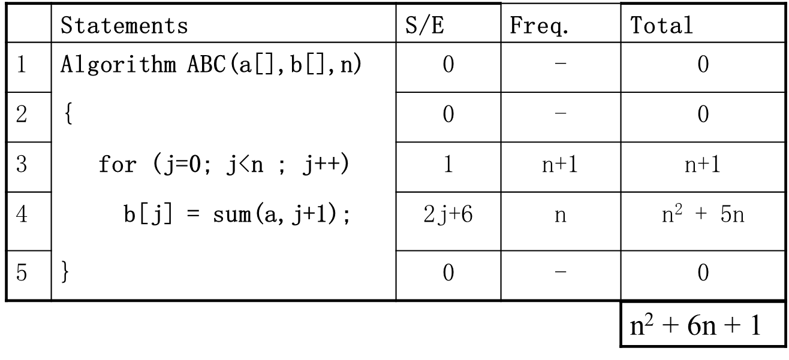
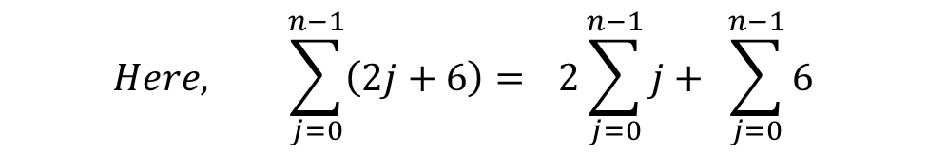
STEP COUNT : EXAMPLE 4

Slide 52
OBSERVATION WITH STEP COUNT
In general, when F(n) = c₁n² + c₂n + c_{3,}
c₁n² is much larger than c₂n + c_{3.}
Which denotes that c₁n² is the dominant term in the F(n).
The value of coefficient is irrelevant.
Thus, to reflect how one function grows with the growth of another function, study of asymptotic notation is required.

Slide 53
GROWTH OF FUNCTIONS
The growth of time and space complexity with increasing input size n is a suitable measure for the comparison of algorithms.
The growth of functions is usually described using the Asymptotic notations
Three most important asymptotic notations are as follows:
  Big – O notation
  Omega notation
  Theta notation

Slide 54
BIG – O NOTATION
Definition: Let f and g be functions from the integers or the real numbers to the real numbers. We say that f(n) is O(g(n)), if there are exist constants C and n₀ such that,
f(n) ≤ C g(n)
whenever n >= n₀ .

Slide 55
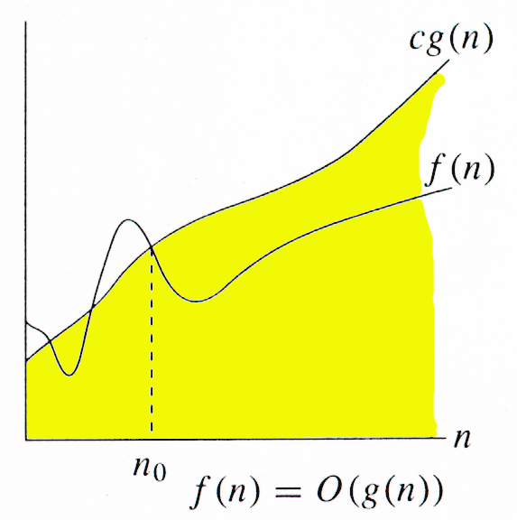
BIG – O NOTATION
Graphically, it can be represented as given in figure.
The idea behind the big-O notation is to establish an upper boundary for the growth of a function f(n) for large n.
We accept the constant C in the requirement
f(n) ≤ Cg(n) whenever n ≥n₀,
because C does not grow with x
We are only interested in large n, so it is OK if
f(n) > Cg(n) for n ≥ n₀.

Slide 56
BIG – O EXAMPLES
Prove that f(n) = 3n + 5 is O(n).
f(n) = 3n + 5
≤ 3n + n , where n ≥ 5
≤ 4n
≤ C g(n) , where C=4 & n₀=5
Hence, f(n) = 3n + 5 is O(n) is proved.
Similarly, Prove for the followings:
  f(n) = 27n² + 16n is O(n²).
  f(n) = 2n³ + n² + 2n is O(n³).
  f(n) = 4n³ + 2n + 3 is O(n³).
  f(n) = 2^{n} + 6n² + 3n is O(2^{n}).

Slide 57
BIG – O EXAMPLES –
INCORRECT BOUND
Prove that f(n) = 7n + 5 ≠ O(1).
Proof by contradiction:
Assume that 7n + 5 = O(1). So, we must have
7n + 5 ≤ C.1 for n ≥ n0.
above statement is not true for large values of n
Hence, our assumption is false.
Hence, f(n) = 3n + 5 is O(n) is proved.
Similarly, Prove for the followings:
  f(n) = 10n² + 7 ≠ O(n).
  f(n) = 27n² + 16n + 25 ≠ O(n).
  f(n) = 3n³ + 4n ≠ O(n²).

Slide 58
BIG – Ω NOTATION
Definition: Let f and g be functions from the integers or the real numbers to the real numbers. We say that f(n) is Ω(g(n)), if there are exist constants C and n₀ such that,
f(n) ≥ C g(n)
whenever n >= n₀ .

Slide 59
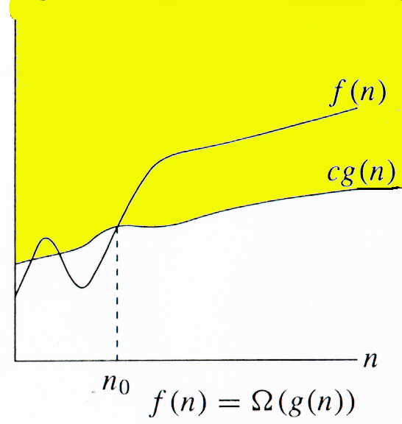
BIG – Ω NOTATION
Graphically, it can be represented as given in figure.
The idea behind the big- Ω notation is to establish an lower boundary for the growth of a function f(n) for large n.
It indicates the best case.

Slide 60
BIG – Ω EXAMPLES
Prove that f(n) = 3n + 5 is Ω(n).
f(n) = 3n + 5
≥ 3n , where n ≥ 1
≥ C g(n) , where C=3 & n₀=1
Hence, f(n) = 3n + 5 is Ω(n) is proved.
Similarly, Prove for the followings:
  f(n) = 27n² + 16n is Ω(n²).
  f(n) = 2n³ + n² + 2n is Ω(n³).
  f(n) = 4n³ + 2n + 3 is Ω(n³).
  f(n) = 2^{n} + 6n² + 3n is Ω(2^{n}).

Slide 61
BIG – Ω EXAMPLES –
INCORRECT BOUND
Prove that f(n) = 7n + 5 ≠ Ω(n²).
Proof by contradiction:
Assume that 7n + 5 = Ω(n²). So, we must have
7n + 5 ≥ C n² for n ≥ n0.
c n² / (7n + 5) ≤ 1.
above statement is not true for n.
Hence, our assumption is false.
Hence, f(n) = 3n + 5 is Ω(n) is proved.
Similarly, Prove for the followings:
  f(n) = 10n² + 7 ≠ Ω(n³).
  f(n) = 27n² + 16n + 25 ≠ Ω(n³).
  f(n) = 3n³ + 4n ≠ Ω(2^{n}).

Slide 62
BIG – ϴ NOTATION
Definition: Let f and g be functions from the integers or the real numbers to the real numbers. We say that f(n) is ϴ(g(n)), if there are exist constants C₁, C₂ and n₀ such that,
C₁ g(n) ≤ f(n) ≤ C₂ g(n)
whenever n >= n₀ .

Slide 63
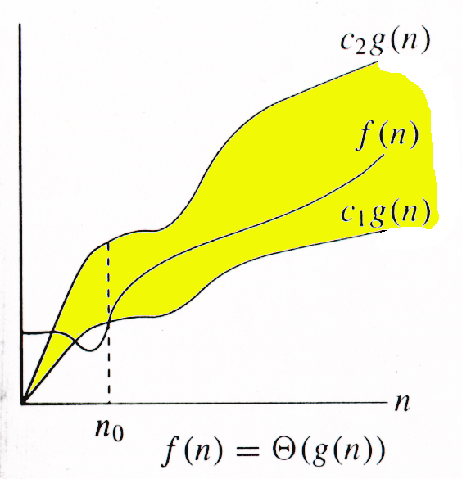
BIG – ϴ NOTATION
Graphically, it can be represented as given in figure.

Slide 64

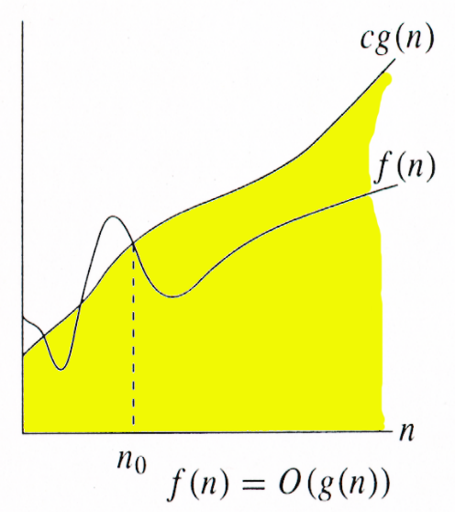

RELATION BETWEEN O, Ω AND ϴ
For any two functions g(n) and f(n), f(n) = Θ(g(n)) iff
f(n) = O(g(n)) and f(n) = Ω(g(n)).
I.e., Θ(g(n)) = O(g(n)) ∩ Ω(g(n))

Slide 65
PROBLEM STATEMENTS
Sorting
Searching
String processing
Graph problems
Combinatorial problems
Geometric problems
Numerical problems

Slide 66
BIG – ϴ NOTATION - EXAMPLES
Prove that f(n) = 3n + 5 is ϴ(n).
We can say that 3n ≤ 3n + 5
C₁ n ≤ f(n), where C₁ = 3
similarly, f(n) = 3n + 5
≤ 3n + n , where n ≥ 5
≤ 4n
≤ C₂ g(n) , where C₂=4
Hence, f(n) = 3n + 5 is ϴ(n) is proved.
Similarly, Prove for the followings:
  f(n) = 27n² + 16n is ϴ(n²).
  f(n) = 2n³ + n² + 2n is ϴ(n³).
  f(n) = 4n³ + 2n + 3 is ϴ(n³).
  f(n) = 2^{n} + 6n² + 3n is ϴ(2^{n}).

Slide 67
DESIGN TECHNIQUE FOR ALGORITHMS
Iterative Algorithm
Divide and Conquer
Greedy Technique
Dynamic Programming
Branch and Bound
Randomized Algorithm
Backtracking Algorithm
Approximation Algorithm

Slide 68
SOLVING LINEAR
RECURRENCE RELATIONS

Slide 69
RECURRENCE RELATION
A recurrence is an equation or inequality that describes a function in terms of its values on smaller inputs.
Running time of recursive algorithms can be obtained by solving recurrence.

Slide 70
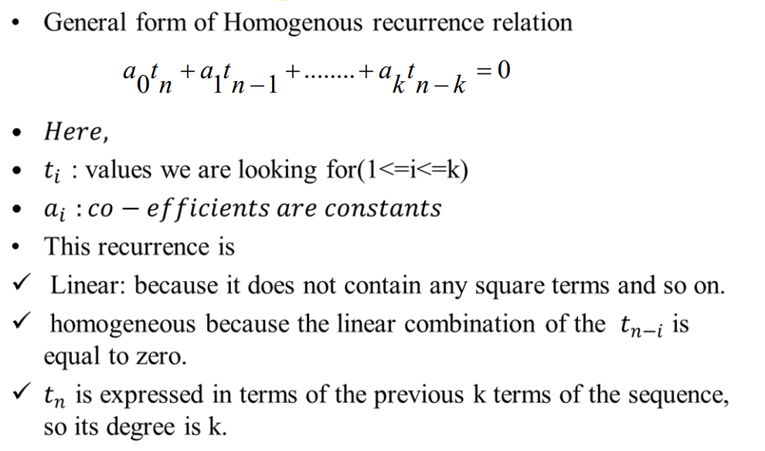
LINEAR HOMOGENEOUS RECURRENCES

Slide 71
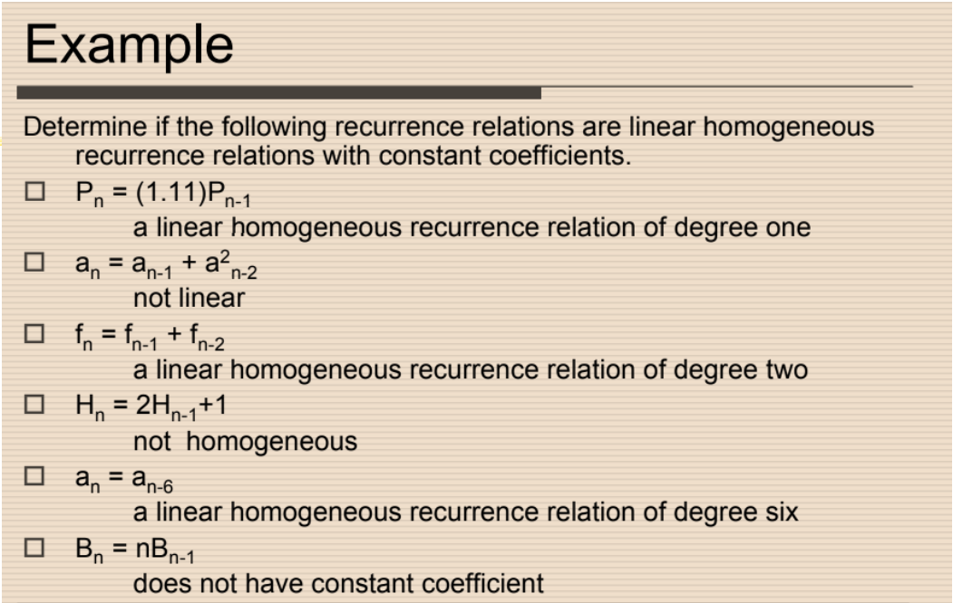
LINEAR HOMOGENEOUS RECURRENCES

Slide 72
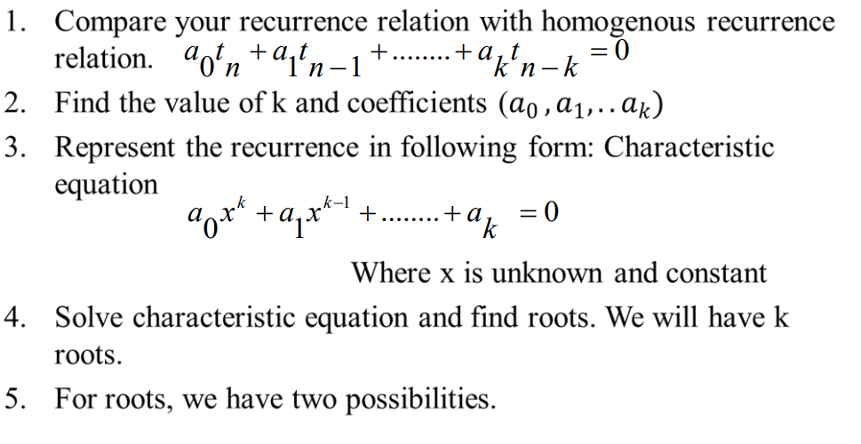
STEPS

Slide 73
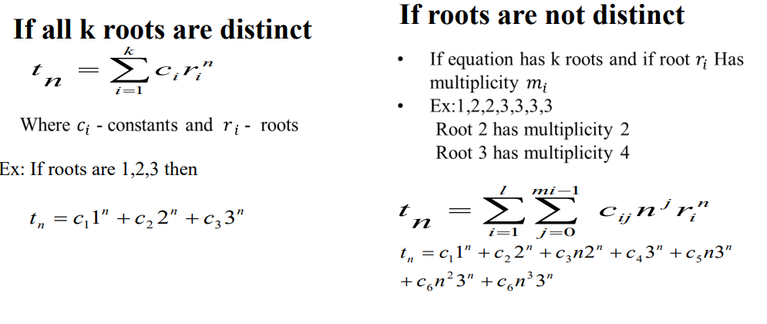
STEPS
For roots, we have two possibilities.

Slide 74
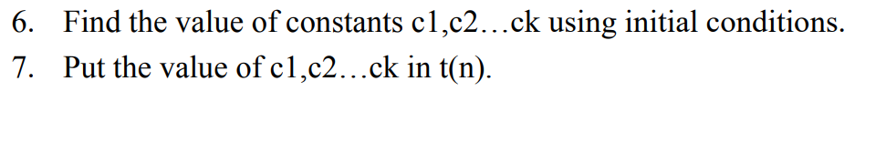
STEPS

Slide 75
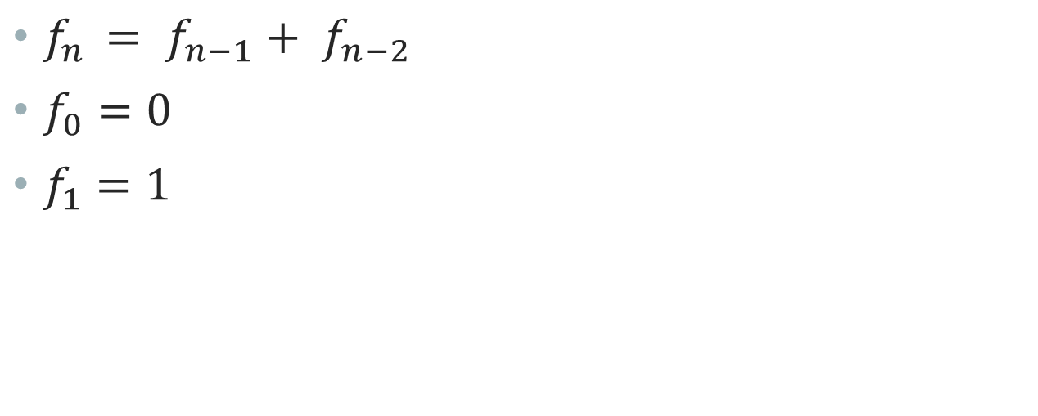
EXAMPLE 1

Slide 76
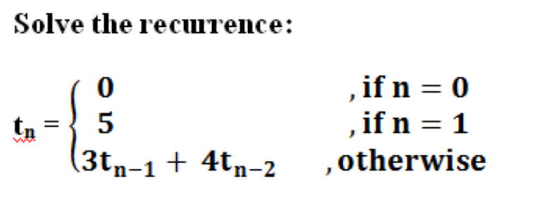
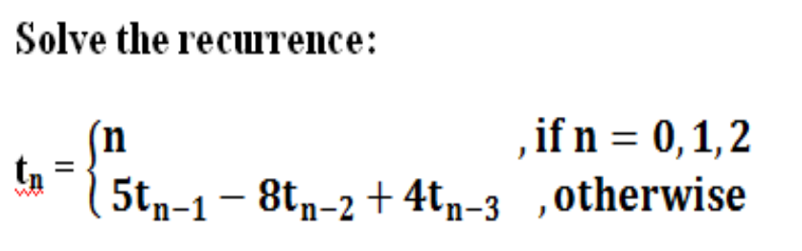
EXAMPLE

Slide 77
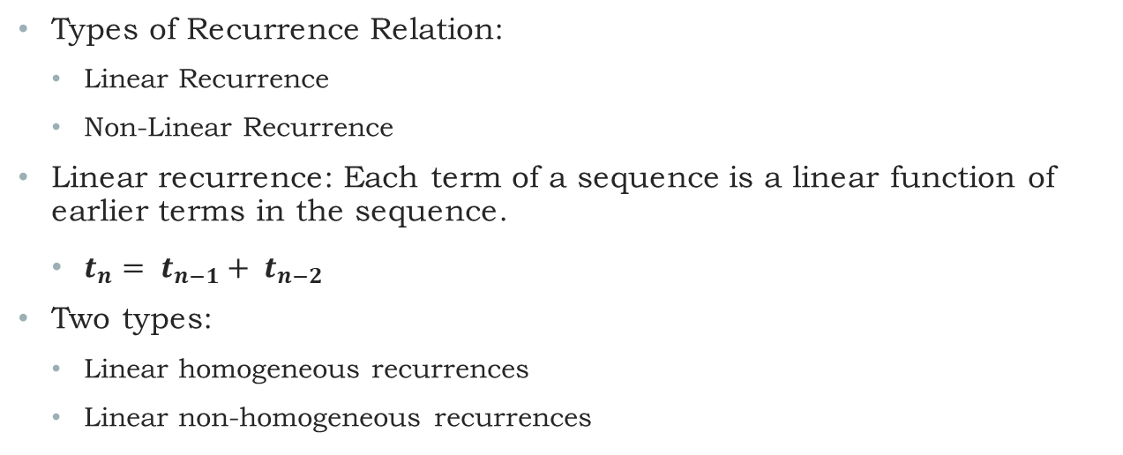
LINEAR RECURRENCES

Slide 78
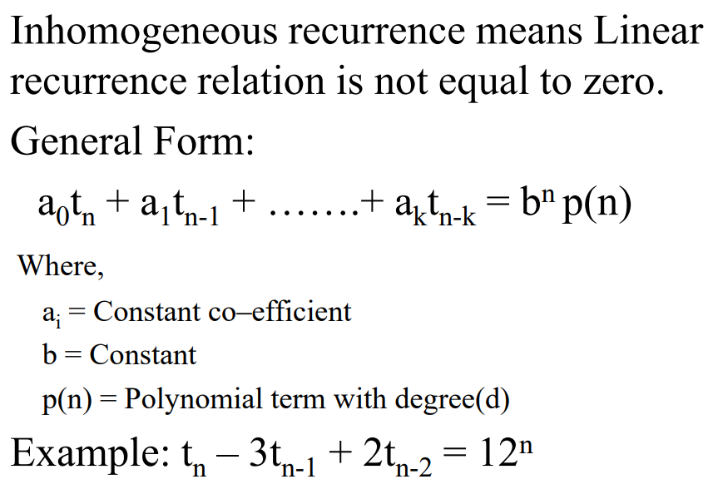
INHOMOGENEOUS RECURRENCE

Slide 79
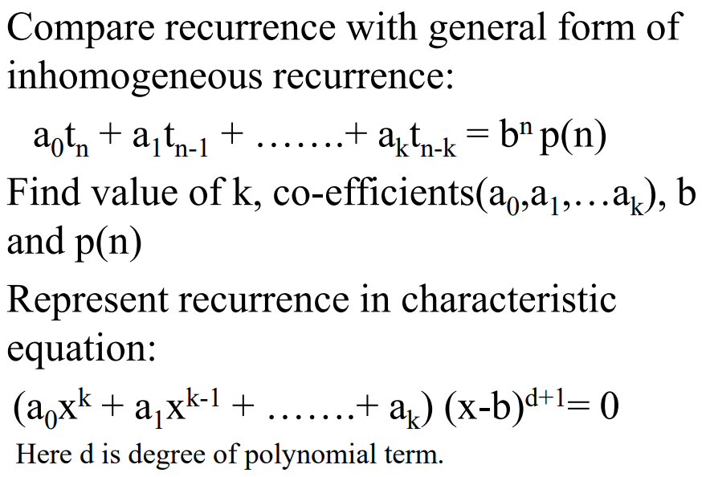
STEPS

Slide 80
STEPS
Solve characteristic equation and find roots.

Slide 81
STEPS

Slide 82
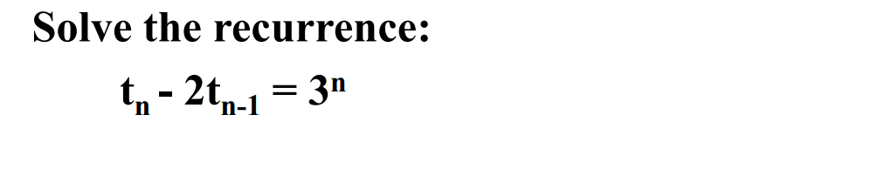
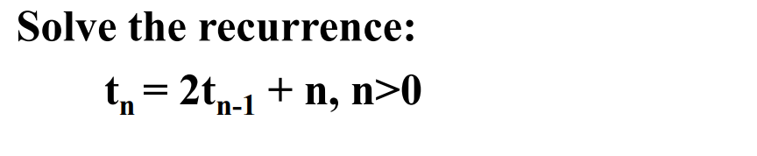
EXAMPLE

Slide 83
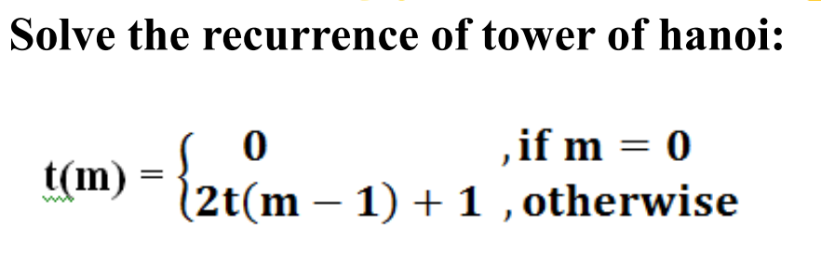
EXAMPLE

Slide 84
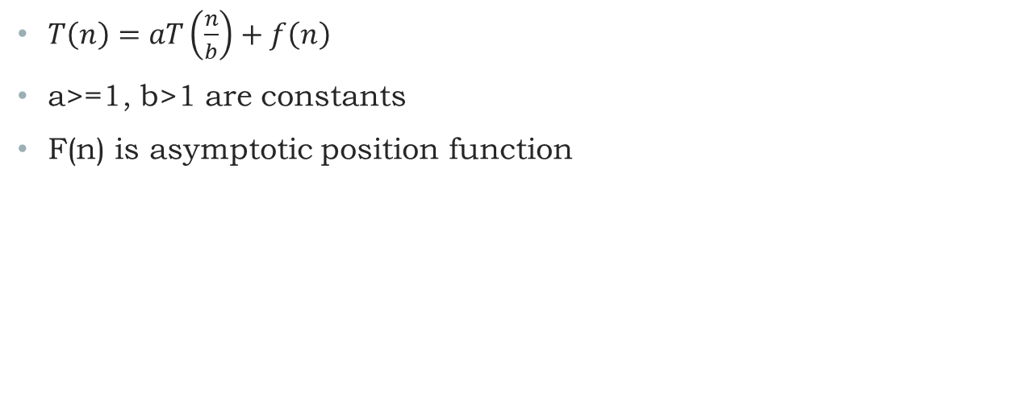
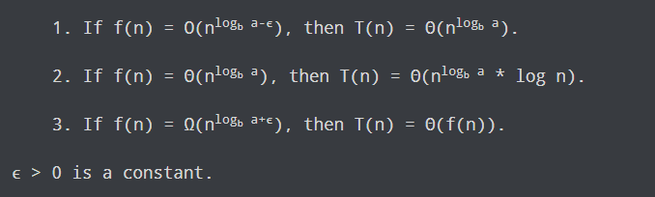
MASTER METHOD

Slide 85
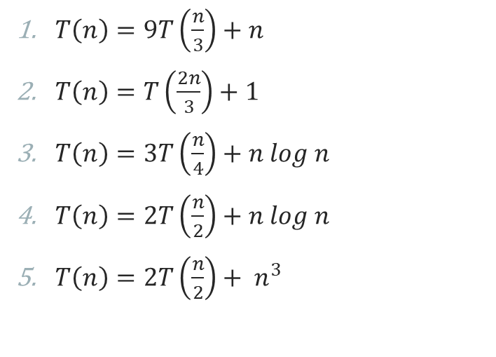
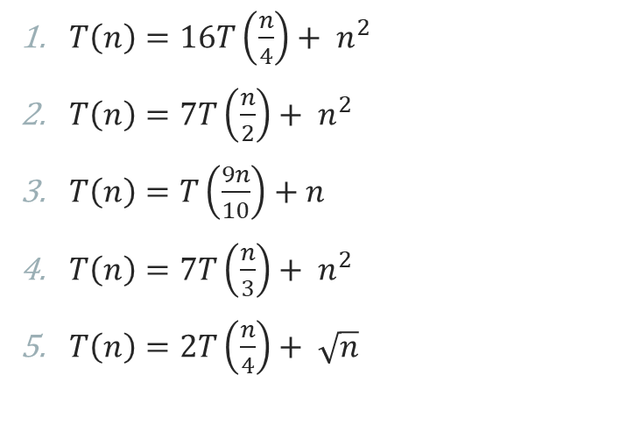
EXAMPLE

Slide 86
RECURSION TREE
Steps to solve recurrence relation using recursion tree method:
  Draw a recursive tree for given recurrence relation
  Calculate the cost at each level.
  Calculate height
  Sum up the cost of all the levels in the recursive tree

Slide 87
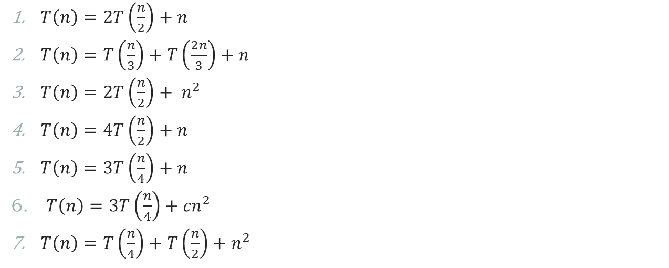
EXAMPLES

Slide 88
Iteration Method
We solve recurrence relations using the iteration method. In this method, we keep substituting the smaller terms again and again until we reach the base condition. Thus the base term can be replaced by its value, and we get the value of the expression.

Slide 89
Example - 1
T(N) = T(N-1) + 1, T(1) = 1
Solution:
Here T(N) = T(N-1) + 1 implies T(N-1) = T(N-2) + 1.
Thus T(N) = (T(N-2) + 1 ) + 1
T(N) = T(N-2) + 2
T(N) = T(N-3) + 3
From the above pattern, we get T(N) = T(N- (N-1)) + (N-1)
Thus T(N) = T(1) + (N-1) and since T(1)=1, T(N)=N.

Slide 90
Example - 2
T(N) = T(N-1) + c, T(1) = c, c is constant
Solution:
Here T(N) = T(N-1) + c implies T(N-1) = T(N-2) + c.
Thus T(N) = (T(N-2) + c ) + c
T(N) = T(N-2) + 2c
T(N) = T(N-3) + 3c
From the above pattern, we get T(N) = T(N- (N-1)) + (N-1)*c
Thus T(N) = T(1) + (N-1)*c and since T(1)=c, T(N)=N*c.
Now, as c is constant T(N) = O(N).
Thus we found that T(N) = O(N) using the iteration method.

Slide 91
Example - 3
T(N) = 2*T(N-1) , T(1) = 1
Solution:
Here T(N) = 2x T(N-1) implies T(N-1) = 2xT(N-2).
T(N) = 2 x (2 x T(N-2) ) = 4 x T(N-2) = 2² x T(N-2)
T(N) = 8 x T(N-3) = 2³ x T(N-3)
Thus from the above patterns we get T(N) = 2^{N-1} x T(N- (N-1)) = 2^{N-1} x T(1) = 2^{N-1}
Thus T(N) = 2^{N-1}

Slide 92
SORTING ALGORITHMS
Bubble sort
Selection sort
Insertion sort
Shell sort
Heap sort
Bucket sort
Radix sort
Counting sort
Merge Sort
Quick Sort

Slide 93
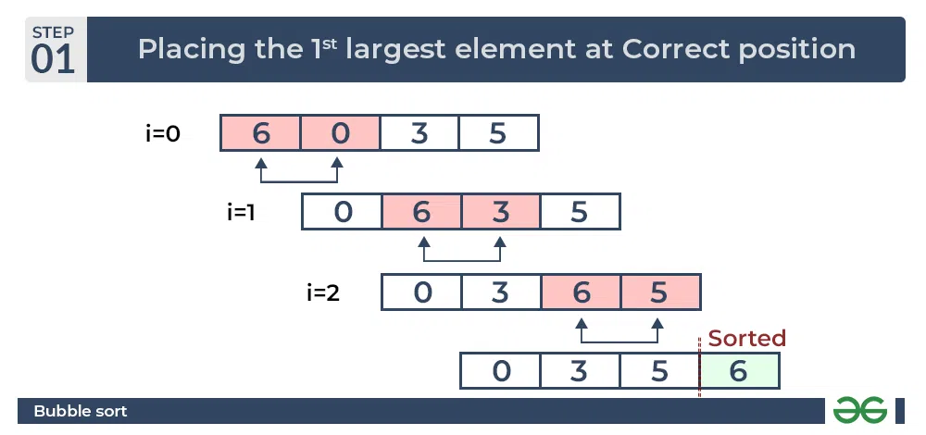
Bubble sort

Slide 94
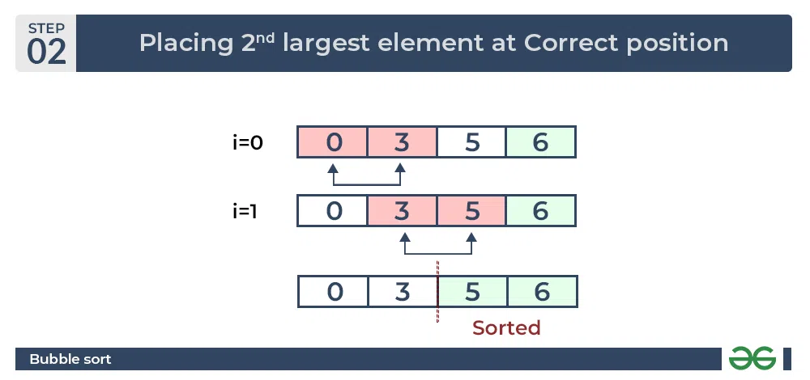
Bubble sort

Slide 95
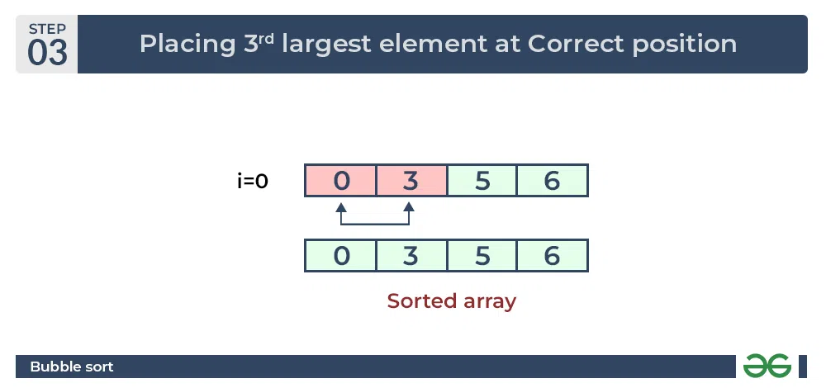
Bubble sort

Slide 96
Bubble sort
void bubbleSort(int arr[], int n)
{
int i, j;
bool swapped;
for (i = 0; i < n - 1; i++) {
swapped = false;
for (j = 0; j < n - i - 1; j++) {
if (arr[j] > arr[j + 1]) {
swap(&arr[j], &arr[j + 1]);
swapped = true;
} }
if (swapped == false)
break;
} }

Slide 97
Analysis of Bubble Sort
Best Case: The best case occurs when the array is already sorted. So the number of comparisons required is N-1 and the number of swaps required = 0. Hence the best case complexity is O(N).
Worst Case: The worst-case condition for bubble sort occurs when elements of the array are arranged in decreasing order.So worst case time complexity is O(N^2)
Average Case Time Complexity: The number of comparisons is constant in Bubble Sort. So in average case, there are O(N^2) comparisons. This is because irrespective of the arrangement of elements, the number of comparisons C(N) is same.
Space: O(1) as no additional space is used.

Slide 98
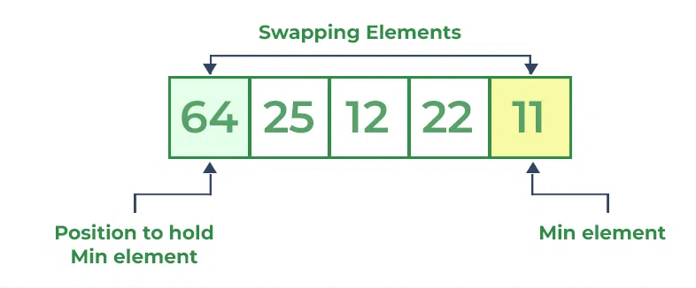
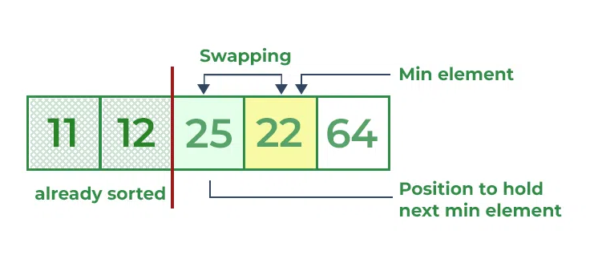
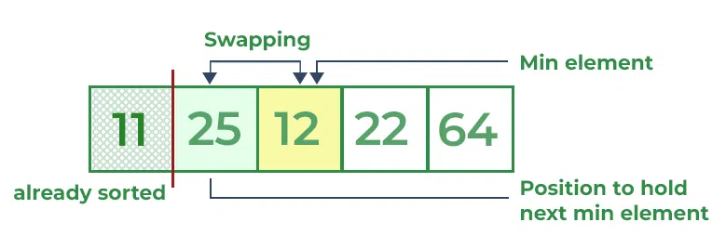
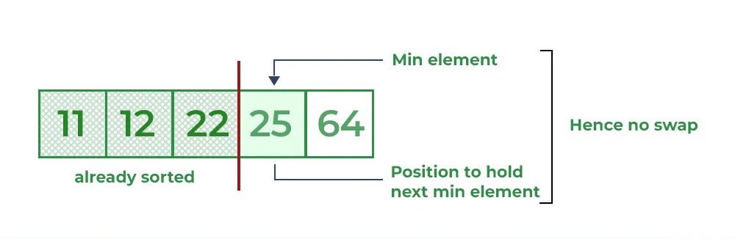
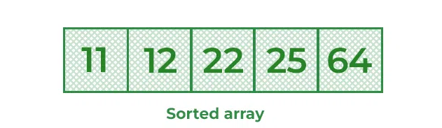
Selection sort
3
1
4
2
5

Slide 99
Selection sort
void selectionSort(int arr[], int n)
{
int i, j, min_idx;
for (i = 0; i < n-1; i++)
{
min_idx = i;
for (j = i+1; j < n; j++)
if (arr[j] < arr[min_idx])
min_idx = j;
if(min_idx != i)
swap(&arr[min_idx], &arr[i]);
}
}

Slide 100
Analysis of Selection Sort
Best-case: O(n^2), best case occurs when the array is already sorted. (where n is the number of integers in an array)
Average-case: O(n^2), the average case arises when the elements of the array are in a disordered or random order, without a clear ascending or descending pattern.
Worst-case: O(n^2), The worst-case scenario arises when we need to sort an array in ascending order, but the array is initially in descending order.
Space Complexity: O(1), as no extra space is required for the Selection sort algorithm

Slide 101
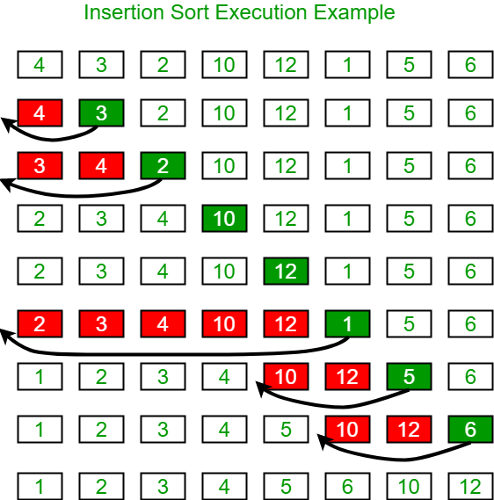
Insertion sort

Slide 102
Insertion sort
void insertionSort(int arr[], int n)
{
int i, key, j;
for (i = 1; i < n; i++) {
key = arr[i];
j = i - 1;
while (j >= 0 && arr[j] > key) {
arr[j + 1] = arr[j];
j = j - 1;
}
arr[j + 1] = key;
}
}

Slide 103
Analysis of Insertion Sort
The worst-case time complexity of the Insertion sort is O(N^2)
The average case time complexity of the Insertion sort is O(N^2)
The time complexity of the best case is O(N).
Space complexity of Insertion Sort is O(1)

Slide 104
Shell sort
Shell sort is mainly a variation of Insertion Sort.
In insertion sort, we move elements only one position ahead. When an element has to be moved far ahead, many movements are involved. The idea of ShellSort is to allow the exchange of far items.
Algorithm:
Step 1 − Start
Step 2 − Initialize the value of gap size. Example: h
Step 3 − Divide the list into smaller sub-part. Each must have equal intervals to h
Step 4 − Sort these sub-lists using insertion sort
Step 5 – Repeat this step 2 until the list is sorted.
Step 6 – Print a sorted list.
Step 7 – Stop.

Slide 105
Shell sort
Pseudocode :
ShellSort(a, n) // 'a' is the given array, 'n' is the size of array
for (interval = n/2; interval > 0; interval /= 2)
for ( i = interval; i < n; i += 1)
temp = a[i];
for (j = i; j >= interval && a[j - interval] > temp; j -= interval)
a[j] = a[j - interval];
a[j] = temp;
End ShellSort

Slide 106

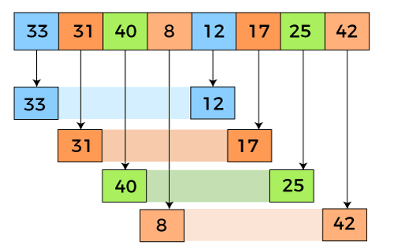
Shell sort
Here, in the first loop, the element at the 0th position will be compared with the element at 4th position. If the 0th element is greater, it will be swapped with the element at 4th position. Otherwise, it remains the same. This process will continue for the remaining elements.
At the interval of 4, the sublists are {33, 12}, {31, 17}, {40, 25}, {8, 42}.
Now, we have to compare the values in every sub-list.

Slide 107

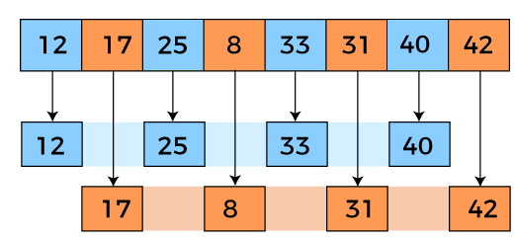
Shell sort
After comparing, we have to swap them if required in the original array. After comparing and swapping, the updated array will look as follows -
In the second loop, elements are lying at the interval of 2 (n/4 = 2), where n = 8.
Now, we are taking the interval of 2 to sort the rest of the array. With an interval of 2, two sublists will be generated - {12, 25, 33, 40}, and {17, 8, 31, 42}.

Slide 108

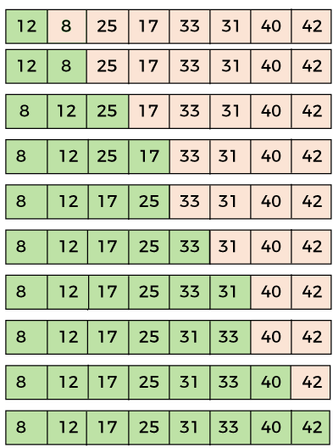
Shell sort
Now, we again have to compare the values in every sub-list.
After comparing, we have to swap them if required in the original array. After comparing and swapping, the updated array will look as follows -
In the third loop, elements are lying at the interval of 1 (n/8 = 1), where n = 8. At last, we use the interval of value 1 to sort the rest of the array elements. In this step, shell sort uses insertion sort to sort the array elements.

Slide 109
Shell sort complexity
Best Case Complexity - It occurs when there is no sorting required, i.e., the array is already sorted. The best-case time complexity of Shell sort is O(n*logn).
Average Case Complexity - It occurs when the array elements are in jumbled order that is not properly ascending and not properly descending. The average case time complexity of Shell sort is O(n*logn).
Worst Case Complexity - It occurs when the array elements are required to be sorted in reverse order. That means suppose you have to sort the array elements in ascending order, but its elements are in descending order. The worst-case time complexity of Shell sort is O(n2).

Slide 110
HEAP SORT
What is Heap?
A heap is a complete binary tree, and the binary tree is a tree in which the node can have utmost two children.
What is a complete binary tree?
A complete binary tree is a binary tree in which all the levels except the last level, i.e., leaf node should be completely filled, and all the nodes should be left-justified.
There are two types of the heap:
Min Heap : The value of the parent node should be less than or equal to either of its children.
Max heap : The value of the parent node is greater than or equal to its children.

Slide 111
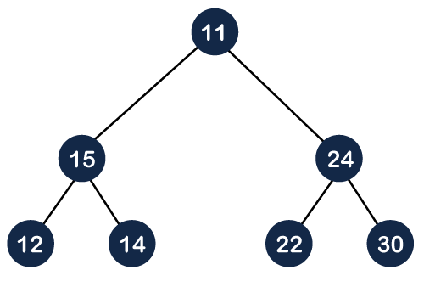
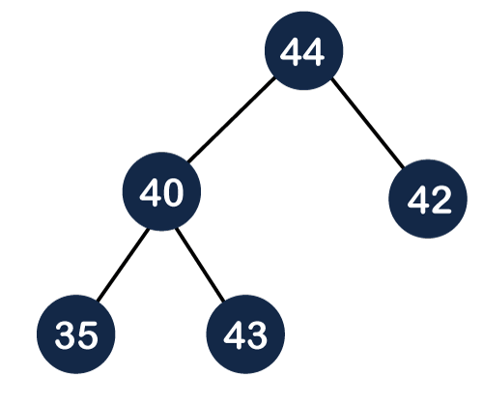
HEAP SORT

Slide 112

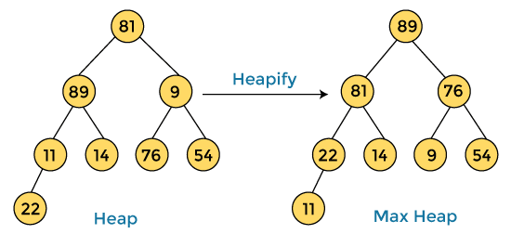

Heap Sort Example
Input array of step 1 →
Step 1 : construct a heap from the given array and convert it into max heap.
Array elements after step 1→

Slide 113
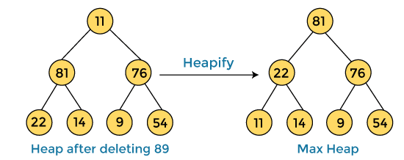

Heap Sort Example
Step 2 :
delete the root element (89) from the max heap.
To delete (89) node, we have to swap it with the last node, i.e. (11). After deleting the root element, we again have to heapify it to convert it into max heap.

Slide 114


Heap Sort Example
Step 3:
Delete the root element (81) from the max heap.
To delete this node, we have to swap it with the last node, i.e. (54).
After deleting the root element, we again have to heapify it to convert it into max heap.

Slide 115


Heap Sort Example
Step 4:
Delete the root element (76) from the max heap again.
To delete this node, we have to swap it with the last node, i.e. (9).
After deleting the root element, we again have to heapify it to convert it into max heap.

Slide 116


Heap Sort Example
Step 5:
Delete the root element (54) from the max heap.
To delete this node, we have to swap it with the last node, i.e. (14).
After deleting the root element, we again have to heapify it to convert it into max heap.

Slide 117


Heap Sort Example
Step 6:
Delete the root element (22) from the max heap.
To delete this node, we have to swap it with the last node, i.e. (11).
After deleting the root element, we again have to heapify it to convert it into max heap.

Slide 118


Heap Sort Example
Step 7:
Delete the root element (14) from the max heap.
To delete this node, we have to swap it with the last node, i.e. (9).
After deleting the root element, we again have to heapify it to convert it into max heap.

Slide 119




Heap Sort Example
Step 7:
Delete the root element (11) from the max heap.
To delete this node, we have to swap it with the last node, i.e. (9).
After deleting the root element, we again have to heapify it to convert it into max heap.
Step 8:
Heap has only one element left. After deleting it, heap will be empty.

Slide 120
Bucket Sort
The data items in the bucket sort are distributed in the form of buckets.
Bucket sort is a sorting algorithm that separate the elements into multiple groups said to be buckets.
Elements in bucket sort are first uniformly divided into groups called buckets, and then they are sorted by any other sorting algorithm. After that, elements are gathered in a sorted manner.
Procedure :
Step 1 : First, partition the range into a fixed number of buckets.
Step 2 : Then, toss every element into its appropriate bucket.
Step 3 : After that, sort each bucket individually by applying a sorting algorithm.
Step 4 : And at last, concatenate all the sorted buckets.

Slide 121
Bucket Sort
Advantages :
Bucket sort reduces the no. of comparisons.
It is asymptotically fast because of the uniform distribution of elements.
Limitations :
It may or may not be a stable sorting algorithm.
It is not useful if we have a large array because it increases the cost.
It is not an in-place sorting algorithm, because some extra space is required to sort the buckets.

Slide 122
Bucket Sort Algorithm
Bucket Sort(A[])
1. Let B[0....n-1] be a new array
2. n=length[A]
3. for i=0 to n-1
4. make B[i] an empty list
5. for i=1 to n
6. do insert A[i] into list B[n a[i]]
7. for i=0 to n-1
8. do sort list B[i] with insertion-sort
9. Concatenate lists B[0], B[1],........, B[n-1] together in order
End

Slide 123

Bucket Sort Example

Slide 124


Slide 125


Slide 126


Slide 127


Slide 128


Slide 129


Slide 130


Slide 131


Slide 132


Slide 133


Slide 134


Slide 135


Slide 136


Slide 137


Slide 138


Slide 139


Slide 140


Slide 141


Slide 142


Slide 143


Slide 144


Slide 145
Algorithm | Time Complexity |  |  | Space Complexity
 | Best | Average | Worst | Worst
Selection Sort | Ω(n^2) | θ(n^2) | O(n^2) | O(1)
Bubble Sort | Ω(n) | θ(n^2) | O(n^2) | O(1)
Insertion Sort | Ω(n) | θ(n^2) | O(n^2) | O(1)
Heap Sort | Ω(n log(n)) | θ(n log(n)) | O(n log(n)) | O(1)
Quick Sort | Ω(n log(n)) | θ(n log(n)) | O(n^2) | O(n)
Merge Sort | Ω(n log(n)) | θ(n log(n)) | O(n log(n)) | O(n)
Bucket Sort | Ω(n +k) | θ(n +k) | O(n^2) | O(n)
Radix Sort | Ω(nk) | θ(nk) | O(nk) | O(n + k)
Count Sort | Ω(n +k) | θ(n +k) | O(n +k) | O(k)
Shell Sort | Ω(n log(n)) | θ(n log(n)) | O(n^2) | O(1)

